Slide 1




Automatic CAD-RADS Scoring using Deep Learning
Felix Denzinger$^{1,2}$, Michael Wels$^{2}$, Katharina Breininger$^{1,2}$, Mehmet A. Gülsün$^{2}$, Florian André$^{3}$, Sebastian Buß$^{3}$, Johannes Görich$^{3}$, Michael Sühling$^{2}$, Andreas Maier$^{1}$
$^{1}$Pattern Recognition Lab, Friedrich-Alexander-Universität Erlangen-Nuremberg, Erlangen, Germany
$^{2}$Computed Tomography, Siemens Healthineers, Forchheim, Germany
$^{3}$Das Radiologische Zentrum - Radiology Center, Sinsheim-Eberbach-Erbach-Walldorf-Heidelberg, Germany
Notes:
Hello and welcome, my name is Felix Denzinger and this is my presentation of our paper entitled automatic… .
Before we dive into the methods

Slide 2
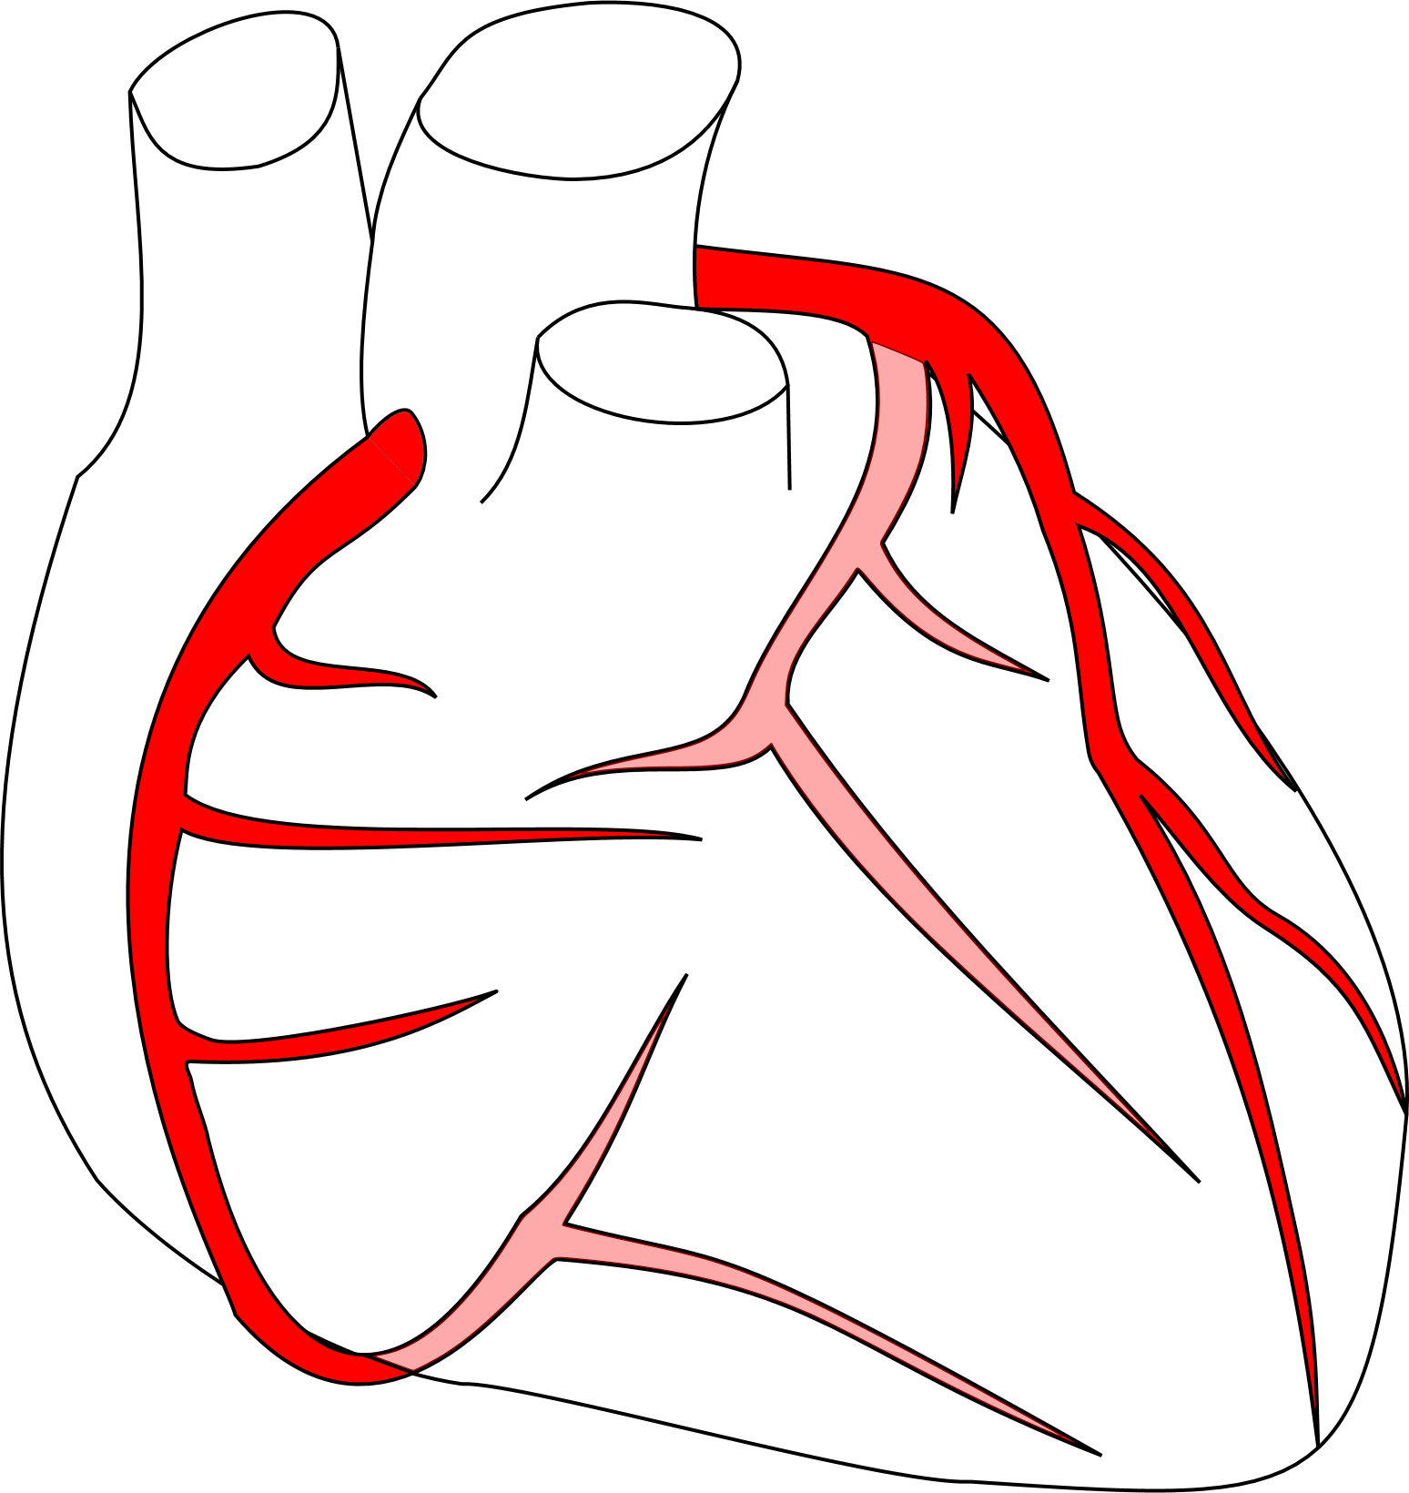
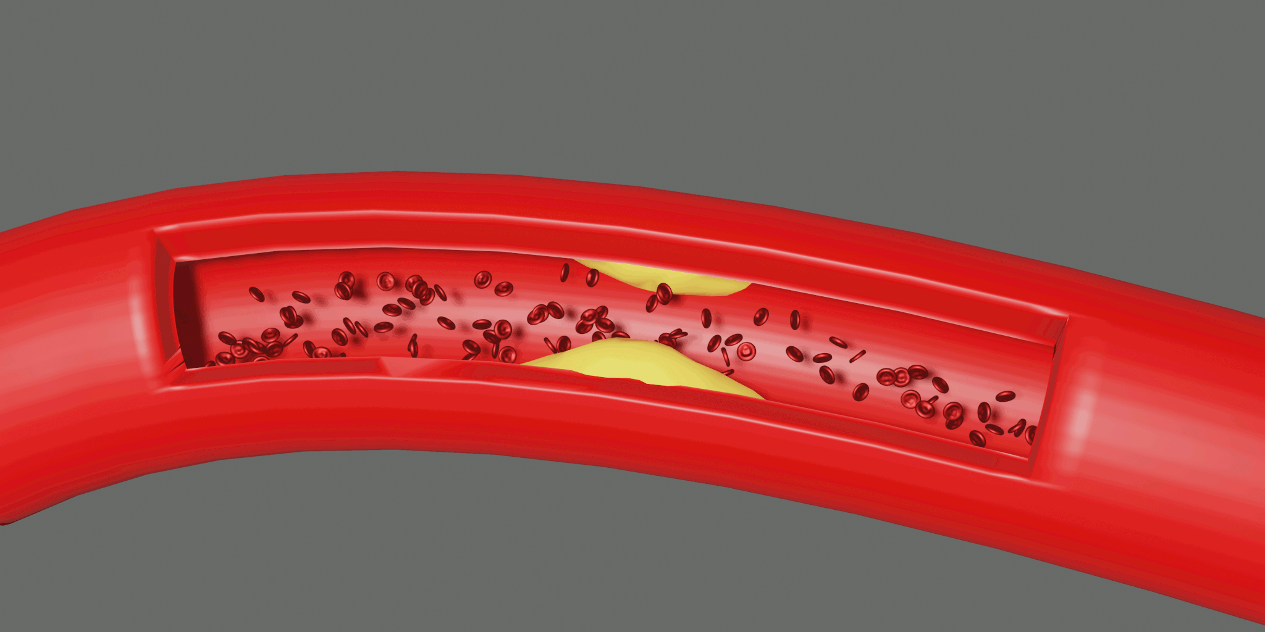
Medical Background
Rupture leading to Stroke/MI
Inflammation of Perivascular Tissue
Plaque Aggregation
Predict Patient Management Score
Blockage leading to Ischemia
Notes:
I want to give a brief introduction of the medical question that motivates this work.
Due to inflammation of the perivascular tissue and pertubations in the blood flow plaque deposits can aggregate within the vessel wall.
These plaque deposists can rupture which leads to adverse events like stroke or myocardiac infarction.
Also they narrow the lumen which in severe cases can lead to a malperfusion of the heart muscle and therefore ischemia.
So the point where this work tries to help with this problem is to automatically predict patient management scores based on coronary CT angiography scans in order to ease the clinical workflow.

Slide 3
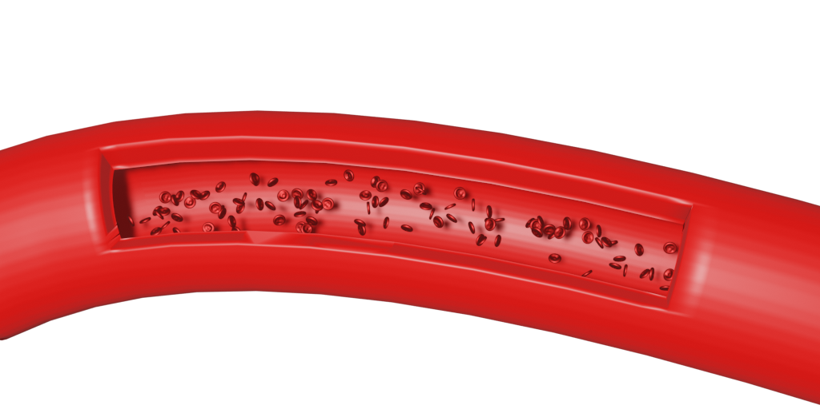
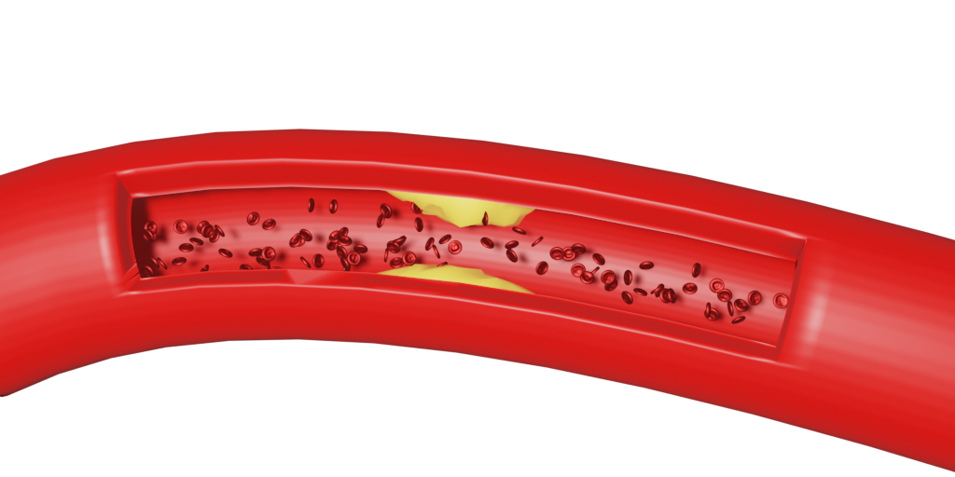
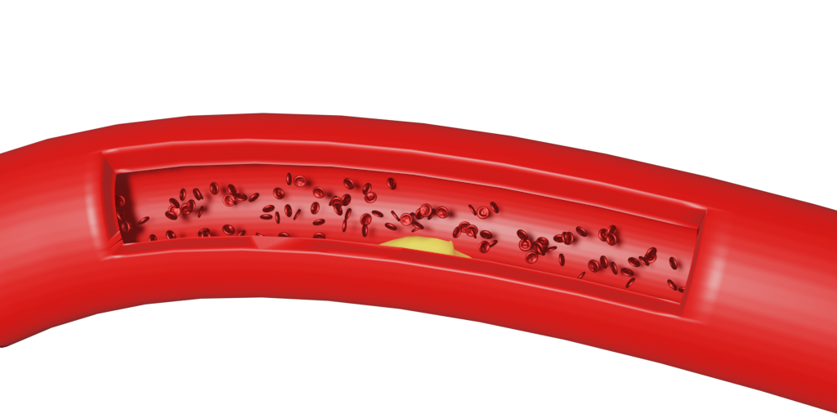
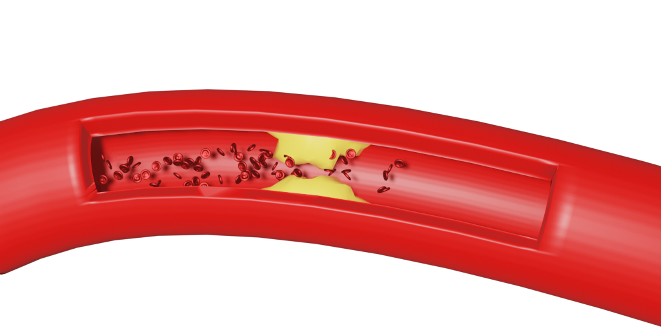
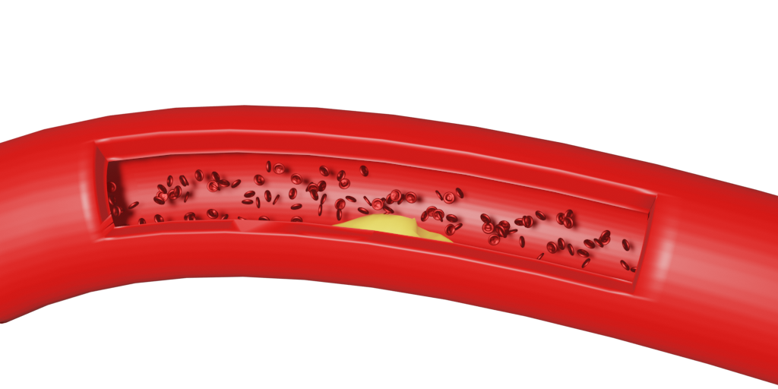
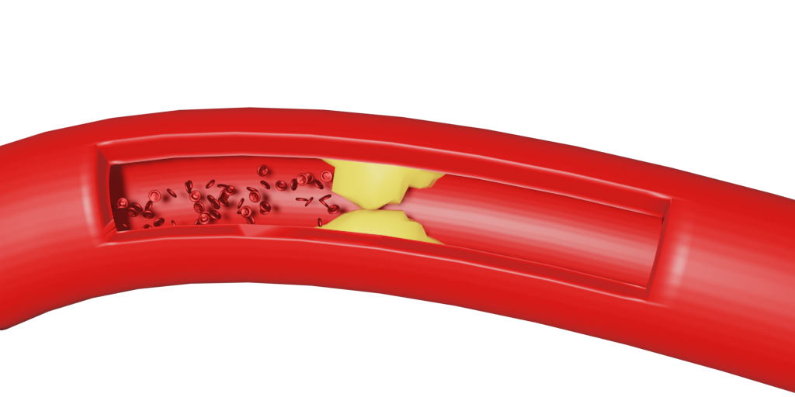
Medical Background: CAD-RADS
0
No Stenosis
No CAD
No Action Required
3
Moderate Stenosis
Consider Functional Assessment
Coronary Artery Disease
-Reporting And
Data System
1
Minimal Stenosis
No Action Required
4
Severe Stenosis
Functional Assessment / ICA*
2
Mild Stenosis
No Action Required
5
Total Occulusion
ICA* / Viability Assessment
Rule-out: CAD-RADS 0 vs 1-5
Hold-out: CAD-RADS 0-2 vs 3-5
*Invasive Coronary Angiography
Notes:
The patient management score we set our sights on is the CAD-RADS score which stands for coronary artery disease reporting and data system.
Mostly it is defined as the most severe stenosis within the patients coronary artery tree. However, the final score is still given by a clinician which also reflects a qualitative component especially for the differentiation of CAD-RADS 0 and 1 since small wall irregularities are already classified as minimal stenosis.
It is divided into 6 grades with 0 standing for : the patient has no coronary artery disease, 1 and 2 for: the patient has a non-obstructive coronary artery disease and with 3-5 the patient has an obstructive coronary artery disease.
The resulting clinical question relevant for the patient management are the rule out case differentiatiating between the patient has a CAD or not and the hold out case where the differentiation is between – the patient needs further functional assessment or an invasive procedure or not. TODO: Differentiation between patientwise stenosis grade and qualitative

Slide 4
Data and Methods
Coronary CT angiography and calcium scoring Scans of 2,828 patients:
Binned stenosis grade labels for each AHA segment
Patient-level Agatston and CAD-RADS scores
Data
Classify the patient-level CAD-RADS score
Task
Use a task specific data representation of the whole coronary artery tree and a hand-crafted neural network to directly predict the CAD-RADS score
Method
Notes:
In our work we leverage a data collection of coronary CT angiography and calcium scoring 2828 patients with stenosis grade labels on segment level where a coronary segment can be seen as an edge in the coronary artery tree. Also the patient level agatston and CAD-RADS score are annotated.
The task at hand is the direct assessment of the patient-level CAD-RADS score and we use a task specific data representation and network architecture to achieve this goal.

Slide 5
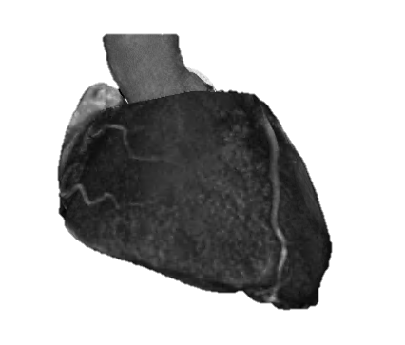
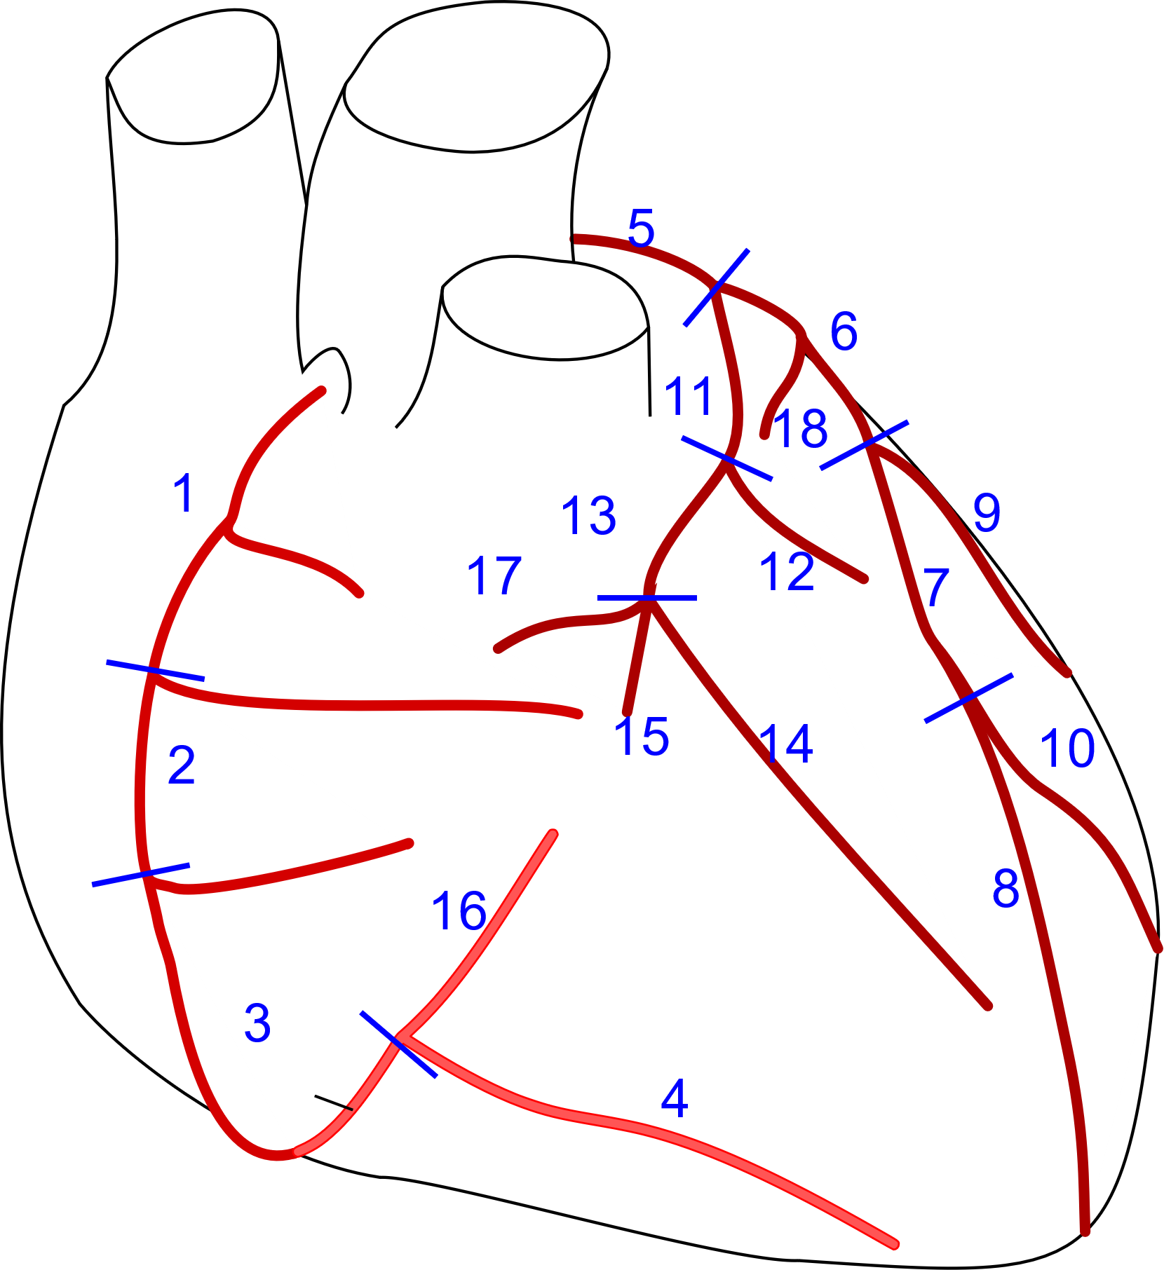
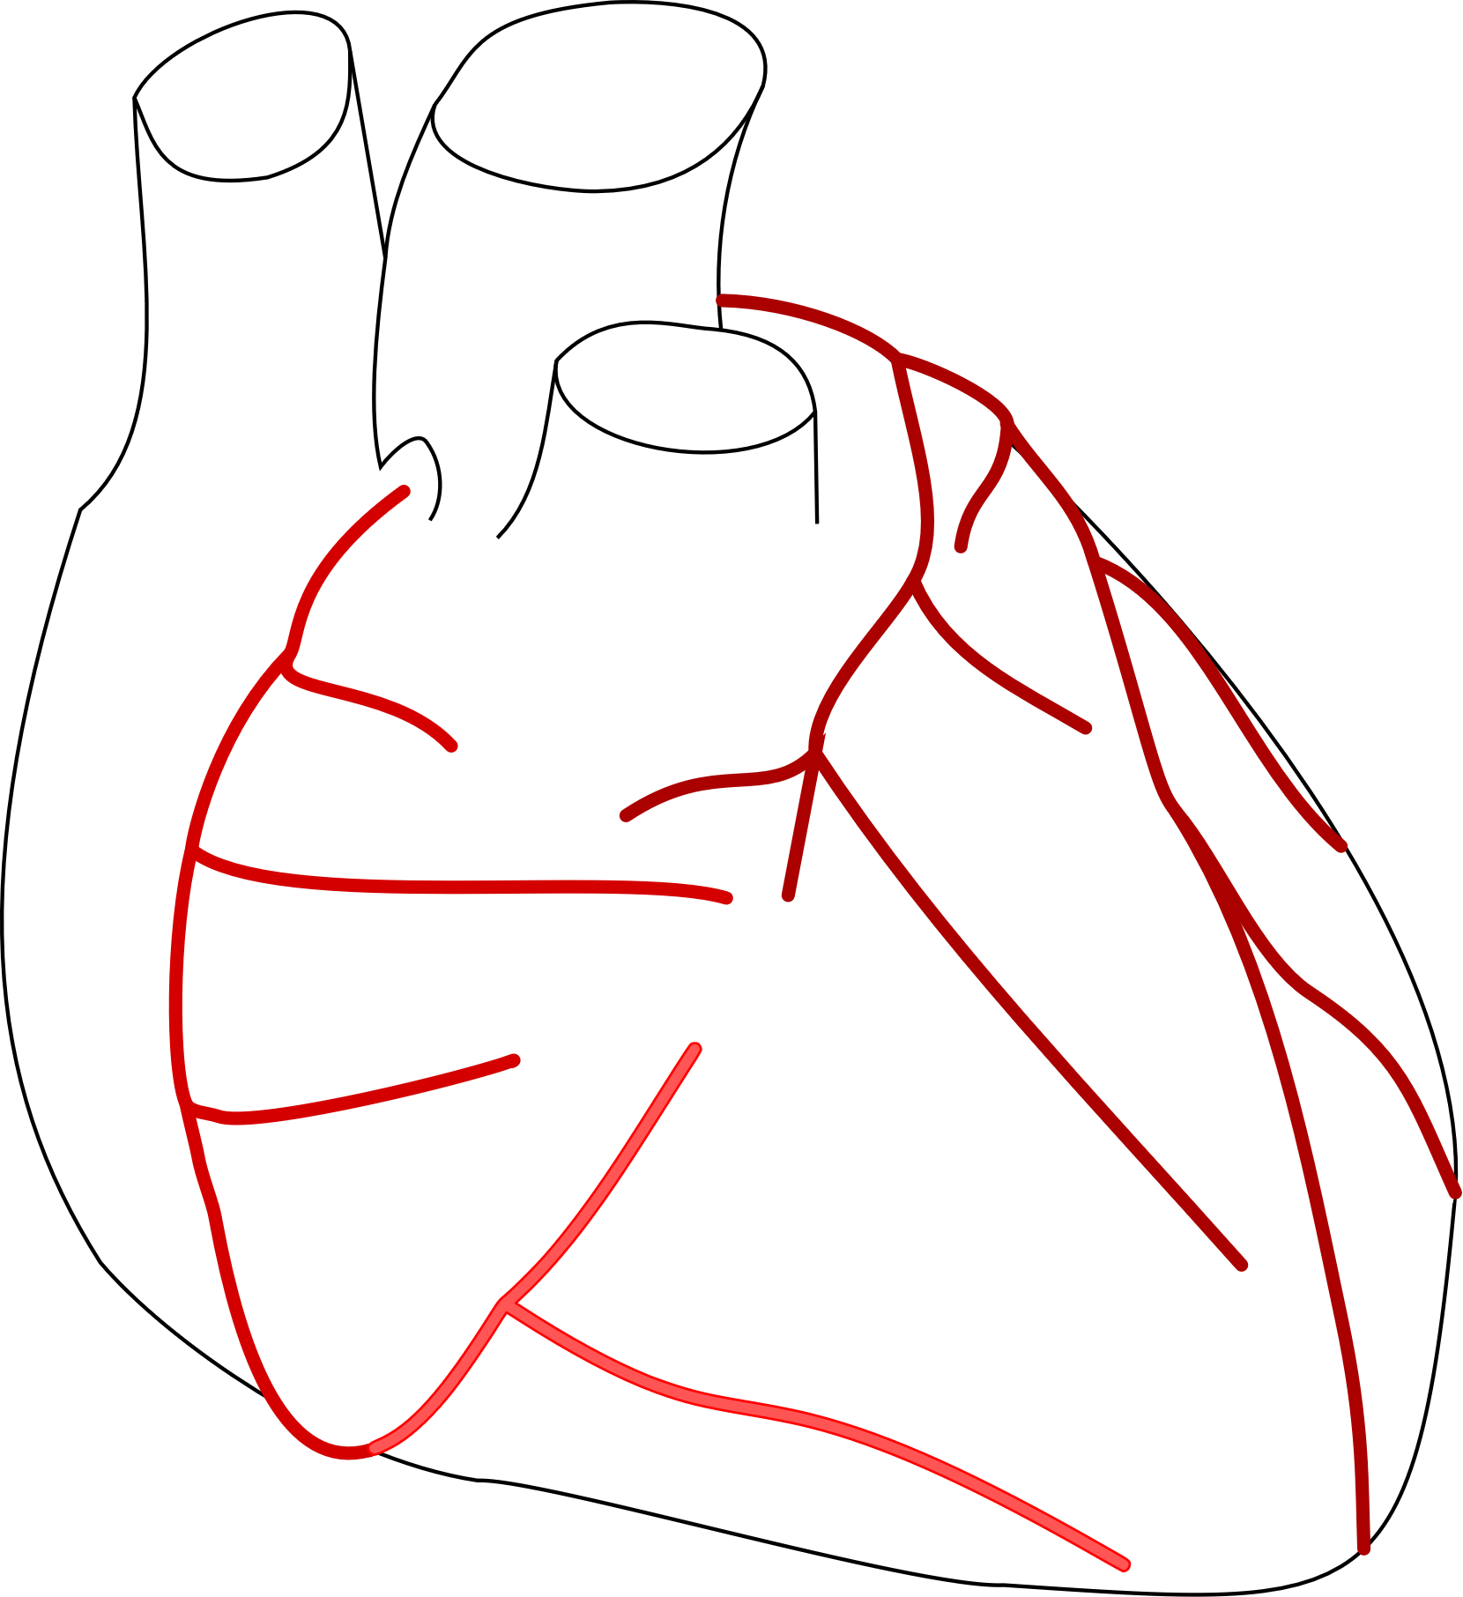




Model Overview
2.5D CNN
Global Max Pooling
Stenosis
CAD-RADS
2.5D CNN
Stenosis
Calcification
2.5D CNN
Stenosis
Have a representation of the whole coronary tree as an input
Condition the CAD-RADS score prediction with the two auxilliary tasks
Independent from a lumen segmentation
Black box
Notes:
The overall workflow of our approach starts with the coronary CT angiography scan.
From these the centerlines of the coronary vasculature are extracted.
Next the subsegments of the coronary tree are labeled.
For all centerlines MPR volume stacks are created by stacking orthogonal planes interpolated for each centerline point.
For simplification reasons we are only looking at the further workflow for a single vessel. The vessel is cut into its subsegments and then all subsegments are resized to the same size to be processable by the neural network.
To reduce the size of the input we use a 2.5D convolutional CNN which takes two orthogonal crosssectional views of our MPR volume stack as an input. After extracting features for each subsegment we use an MLP to regress the stenosis degree.
The features for each subsegment are also combined using a global max pooling operation. This operation is well motivated by the definition of the CAD-RADS score which mainly corresponds to the most severe lesion within the patient.
Therefore the CAD-RADS score is regressed by this pooled feature representation together with a calcification score as an additional auxilliary target.
So summerizing our approach leverages a data representation of the whole coronary tree as an input.
It does use two auxilliary tasks in a multi-task setup in order to condition the CAD-RADS score prediction in the right direction.
Also a big advantage of this approach is ist independence from a lumen segmentation which is time consuming, often requires manual correction and is a potential source of error.
On the downside our approach as most DL based approaches is kind of a black box, which should be tackled by the use of visualizationtechniques in future work.
After presenting our approach I want to present the corresponding results.

Slide 6
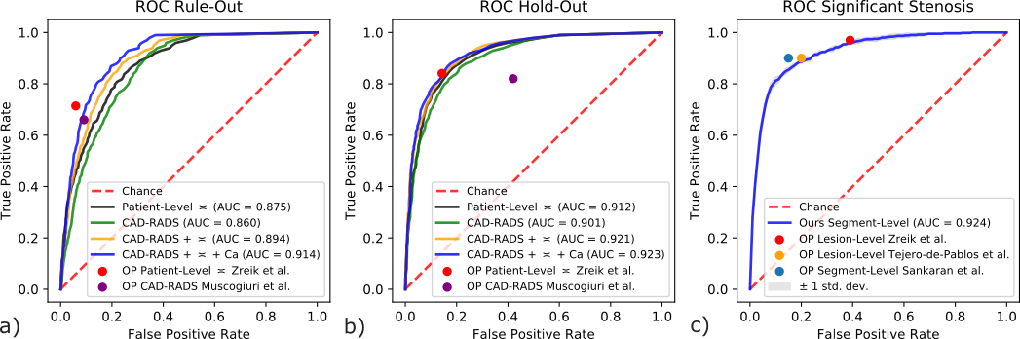
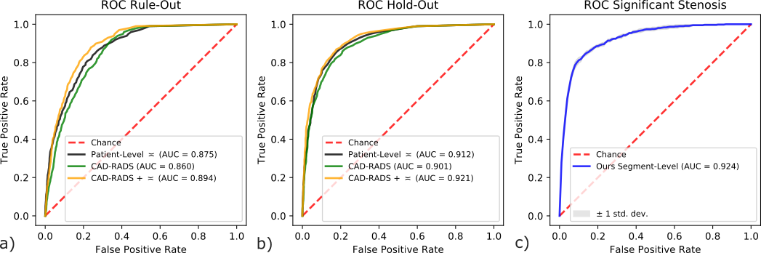
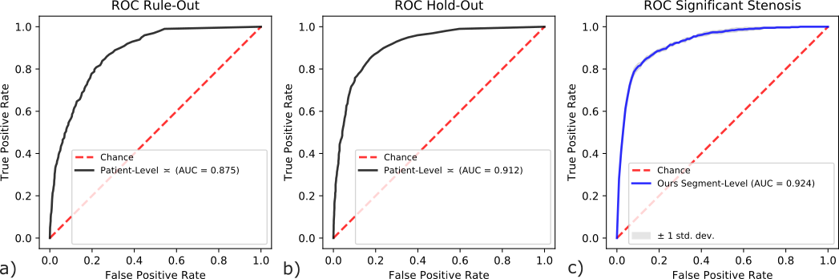
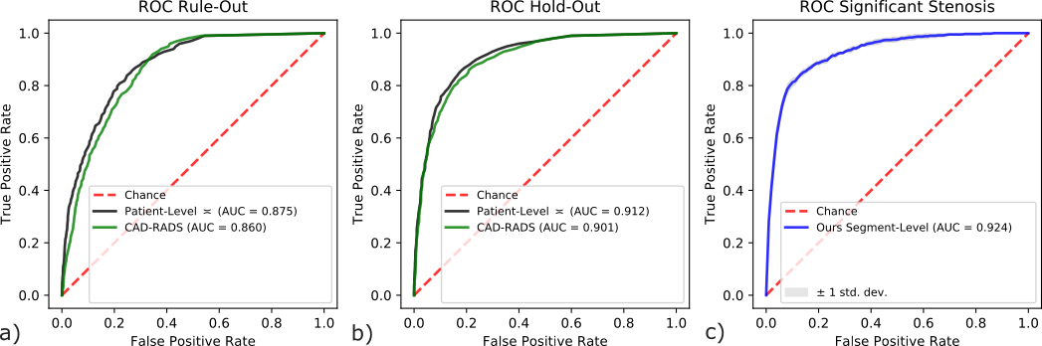
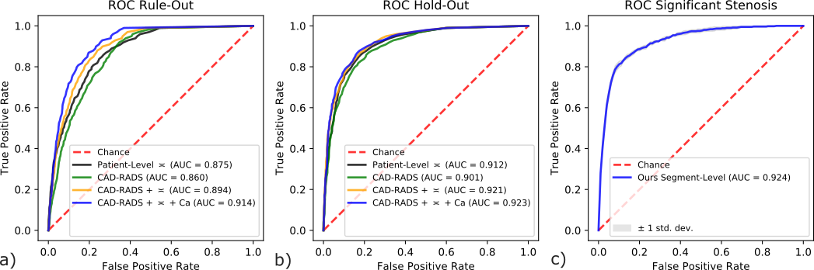
Results
Notes:
As the baseline we chose a direct prediction of the most severe segment within a patient. This is the closest we can get to related work which mainly predicts the most severe lesion within a patient.
Also we reach a good performance for the prediction of significant stenosis on a segment level.
When we directly predict the CAD-RADS score without any auxilliary targets we do not quite reach the performance of this baseline.
However, as soon as we use the segment wise stenosis degree as an auxilliary target we clearly outperform this baseline.
Especially the rule out case performance is enhanced even more when the global calification grade is considered as well.
Unfortunately we were not able to apply related work algorithms on our dataset since we only have segment wise labels and relabeling on a lesion level was out of scope for this work. Also the results are not directly comparable since they predict the most severe stenosis degree instead of the CAD-RADS score which is similar but not equal to each other especially between CAD-RADS 0 and 1.
We still want to show their operating points on these tasks which were performed on their data sets which are atmost 15x smaller then the data set we have worked with.

Slide 7
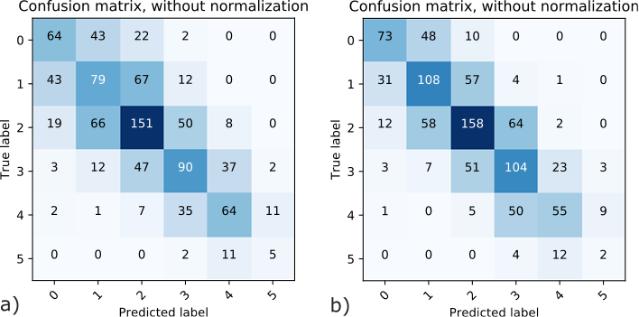
Results cont.
Segment-wise
Direct
Notes:
Regarding the missclassifications we see that especially the CAD-RADS 0 and 1 case gets better predicted by our full approach.
Another takeaway from this slide is that CAD-RADS 5 is extremely hard to predict.
Since is for once because of the severe class imbalance for this case but also since our approach relies on a prior centerline extraction which cannot be performed if a vessel is fully occluded.

Slide 8
Summary
First approach to predict the CAD-RADS score with all six classes using a hierarchical data representation of the coronary arteries, a handcrafted neural architecture and auxilliary tasks.
Very good performance with considerably more test data than related approaches.
Future work will address the use of test time augmentations and localization of culprit segments using saliency
Notes:
Summarizing we are presenting the first approach to predict this score with all six classes using a task specific data representation and neural architecture levaraging two auxilliary tasks.
We do achieve very good performance with significantly more test data than related approaches.
Furthermore, we believe that our approach can be further improved by the use of test time augmentation and culprit segments can be not only be detected by the stenosis grade score but also by the use of visualization techniques.

Slide 9
Automatic CAD-RADS Scoring using Deep Learning
F. Denzinger, M. Wels, K. Breininger, M. A. Gülsün, M. Schöbinger, F. André, S. Buß, J. Görich, M. Sühling, and A. Maier
Coronary Artery Disease-Reporting and Data System – Standardized System for the Assessment of CAD
Approach
2.5D CNN
Global Max Pooling
Stenosis
CAD-RADS
2.5D CNN
Stenosis
Calcification
…
…
…
2.5D CNN
Stenosis
Main Contributions
Direct CAD-RADS Scoring from CCTA Scans
Task Specific Hierarchical Data Representation
First Approach to Predict All Six Grades
Data Collection of 2867 Patients
Notes:
With this I thank you for watching our presentation and am happy two answer your question during the sessions.

